Slide 1
BLOOD BANK MANAGEMENT SYSTEM
Presenters:
Yaswanth Ijjurotula
Darshan Jigala Channa Reddy
Vinitha Uppunuru
Shayna Guilfoyle
Sharanya Saravanan
Nischay Kamshetty

Slide 2



INTRODUCTION
Inefficient manual blood bank operations prompt the need for a modernized solution. Our proposal introduces a database system to streamline blood stock management, donor registration, and distribution processes. Manual tracking is error-prone and outdated, risking wastage and shortages. Our system, comprising of eight interconnected entities, ensures precise blood tracking and efficient donor management, aiming to provide safe blood promptly and enhancing inventory and registration processes.

Slide 3
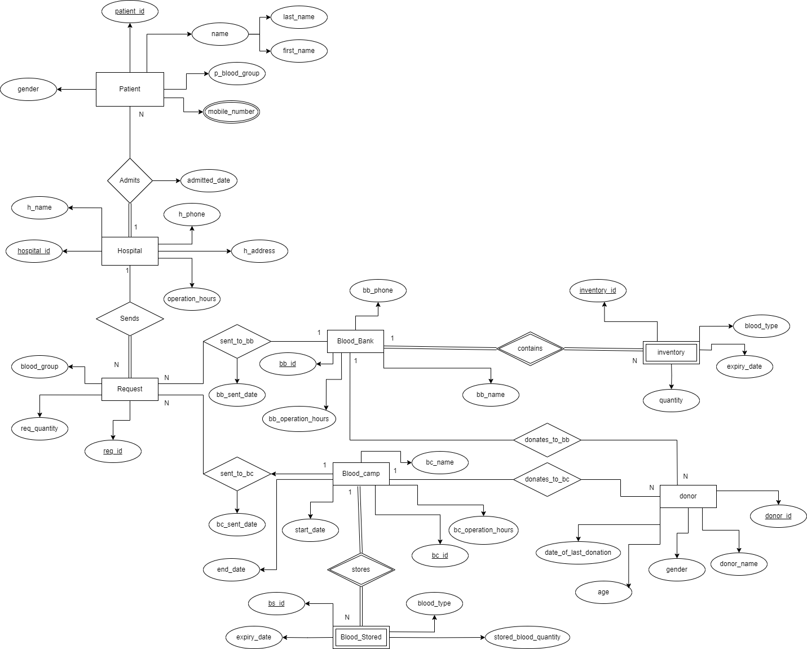

ER DIAGRAM

Slide 4
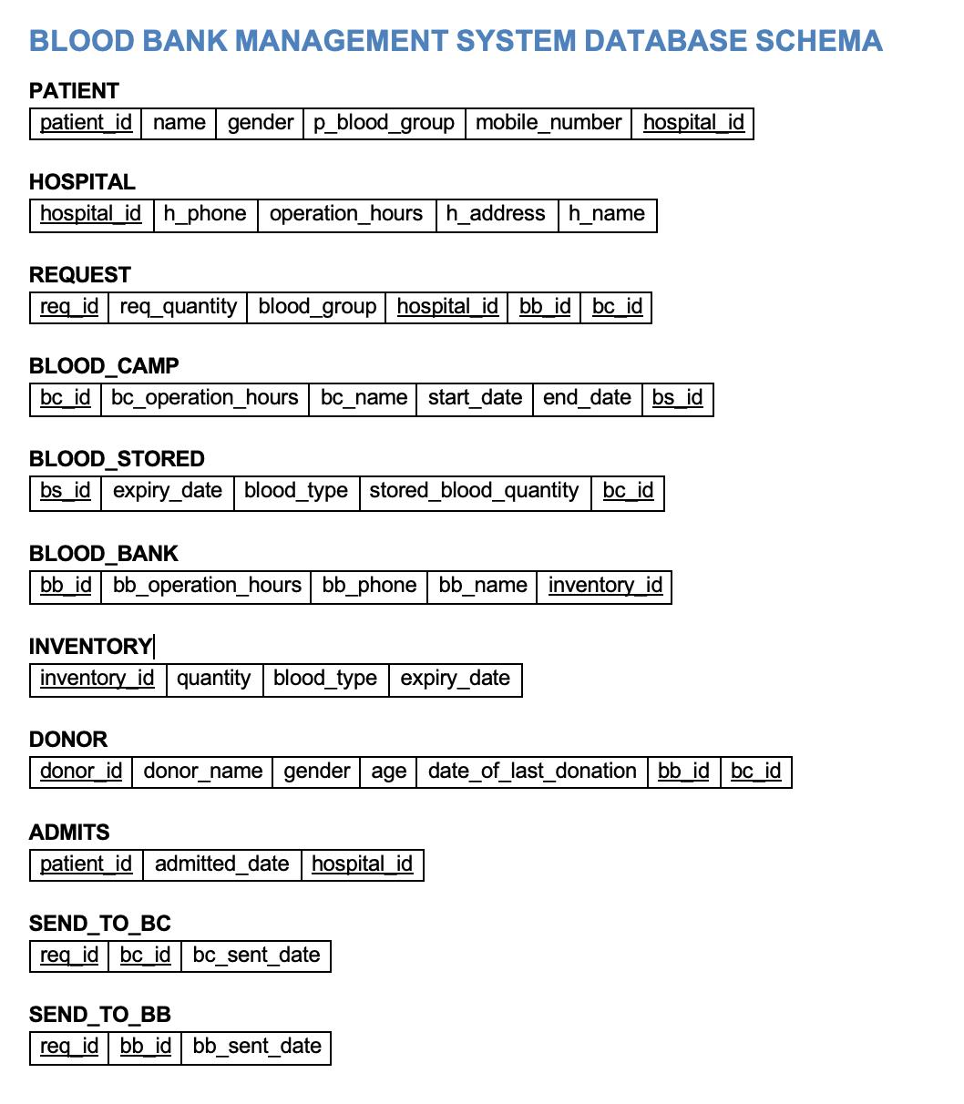






RELATIONAL SCHEMA

Slide 5
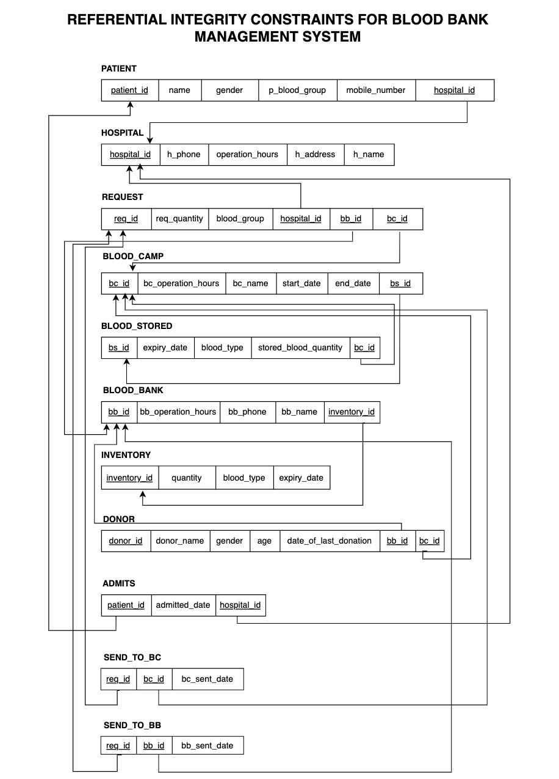
REFERENTIAL INTEGRITY CONSTRAINTS

Slide 6

NORMALIZATION
All tables are in third normal form.
First Normal Form (1NF) –
Ensures that each column in a table contains atomic values, meaning there are no repeating groups or arrays. Each cell holds a single value.
Second Normal Form (2NF) –
Builds upon 1NF by ensuring that all non-key attributes are fully functionally dependent on the primary key, meaning no partial dependencies exist.
Third Normal Form (3NF) –
Further refines the structure by eliminating transitive dependencies, ensuring that every non-key attribute is non-transitively dependent on the primary key.

Slide 7
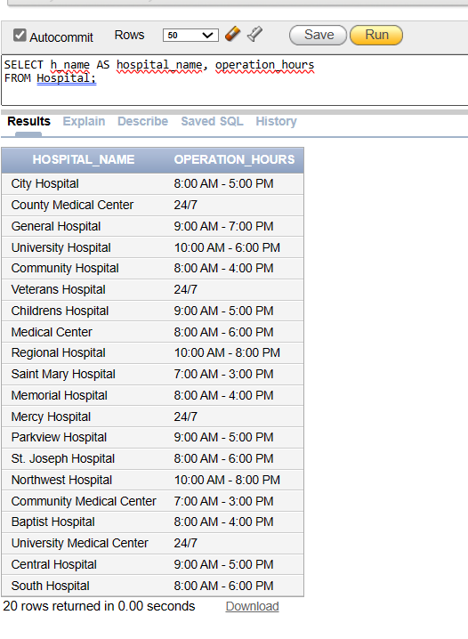
SAMPLE SQL QUERIES
Query to retrieve the names of all hospitals and their operation hours.
Query:
SELECT h_name AS hospital_name, operation_hours
FROM Hospital;

Slide 8
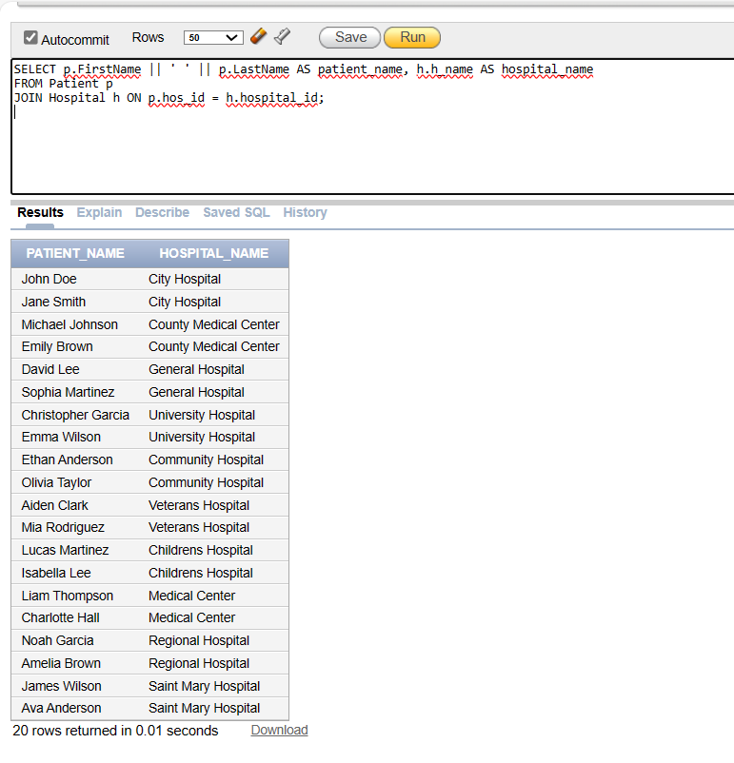
Query to retrieve the names of patients along with the names of the hospitals they are admitted to. Query: SELECT p.FirstName || ' ' || p.LastName AS patient_name, h.h_name AS hospital_name FROM Patient p JOIN Hospital h ON p.hos_id = h.hospital_id;

Slide 9
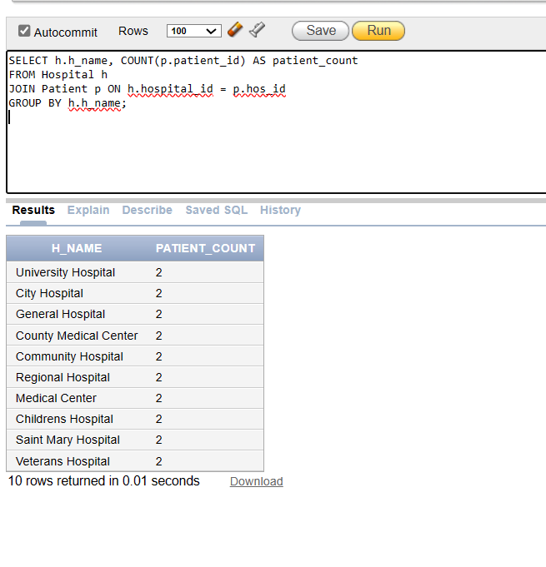


Query to count the number of patients in each hospital.
Query:
SELECT h.h_name, COUNT(p.patient_id) AS patient_count
FROM Hospital h
Patient p ON h.hospital_id = p.hos_id
GROUP BY h.h_name;

Slide 10
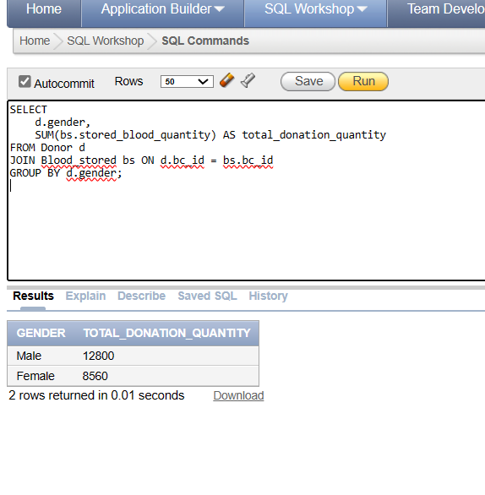
Query to calculate the total blood donation quantity by gender.
Query:
SELECT d.gender, SUM(bs.stored_blood_quantity) AS total_donation_quantity
FROM Donor d
JOIN Blood_stored bs ON d.bc_id = bs.bc_id
GROUP BY d.gender;
2024

Slide 11
Query to retrieve requested blood groups that are available at specific blood donation camps and provides the names of those camps.
Query:
SELECT DISTINCT bs.blood_type as Requested_blood_group, bc.bc_name as Available_at_blood_camps FROM blood_camp bc,blood_stored bs WHERE bs.bc_id = bc.bc_id AND bs.blood_type in(SELECT DISTINCT r.blood_group FROM request r) AND bs.stored_blood_quantity > 0
GROUP by bs.blood_type,bc.bc_name
ORDER by bs.blood_type;

Slide 12
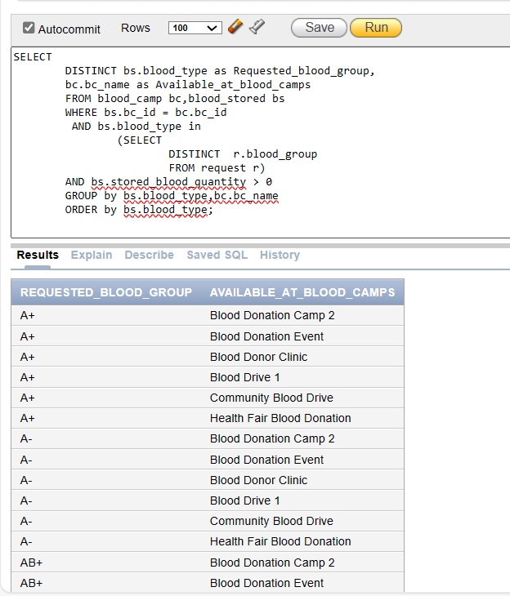
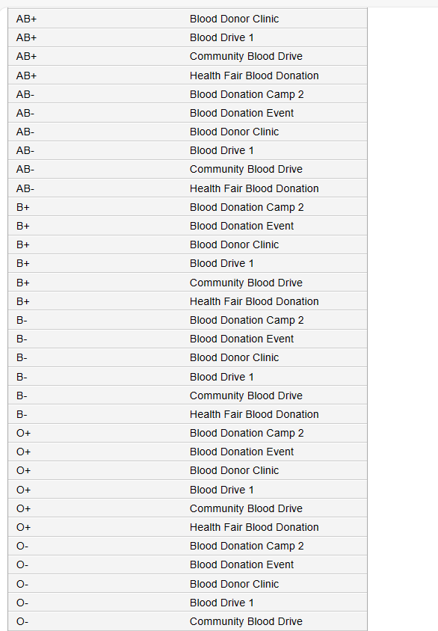

Slide 13
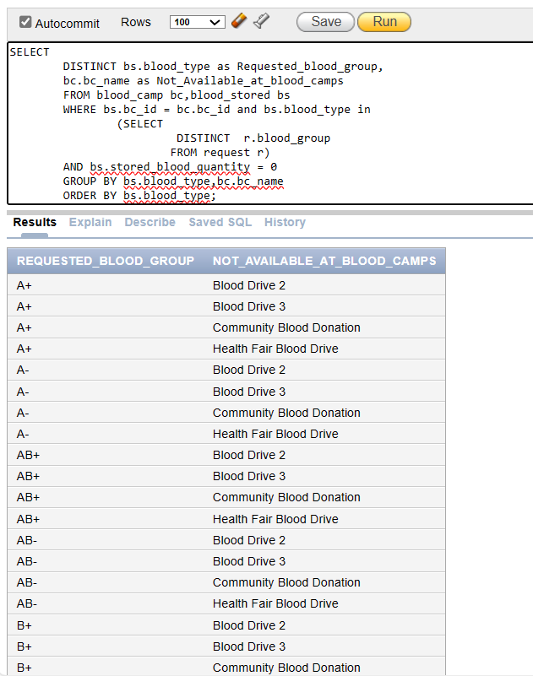

Query to retrieve requested blood groups that are not available at specific blood donation camps and provides the names of those camps.
Query:
SELECT DISTINCT bs.blood_type as Requested_blood_group, bc.bc_name as Not_Available_at_blood_camps
FROM blood_camp bc,blood_stored bs WHERE bs.bc_id = bc.bc_id and bs.blood_type in (SELECT DISTINCT r.blood_group FROM request r) AND bs.stored_blood_quantity = 0 GROUP BY bs.blood_type,bc.bc_name
ORDER BY bs.blood_type;

Slide 14
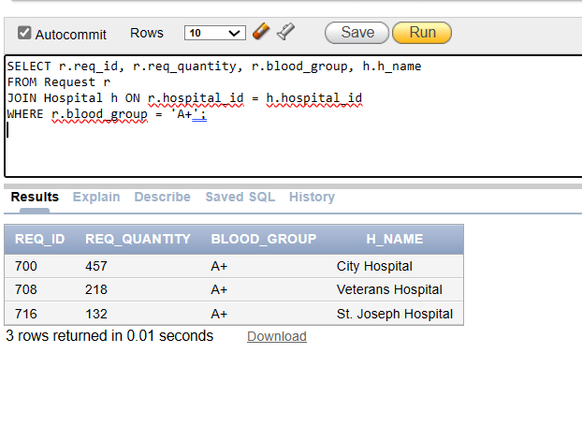
Query to Identify blood requests for specific blood group and hospital.
Query:
SELECT r.req_id, r.req_quantity, r.blood_group, h.h_name
FROM Request r
JOIN Hospital h ON r.hospital_id = h.hospital_id
WHERE r.blood_group = 'A+’;

Slide 15
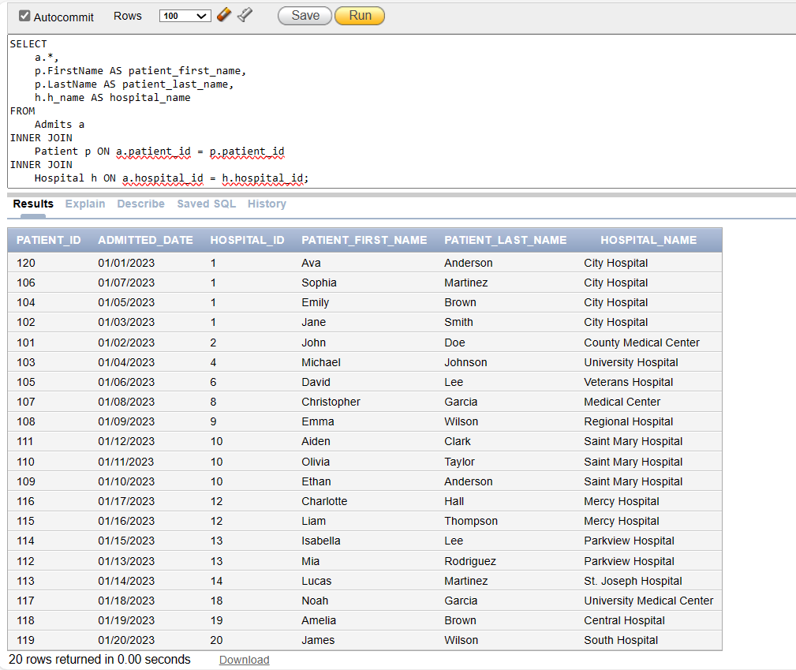
Query to fetch all admissions with corresponding patient and hospital.
Query:
SELECT a.*, p.FirstName AS patient_first_name, p.LastName AS patient_last_name, h.h_name AS hospital_name FROM Admits a
INNER JOIN Patient p ON a.patient_id = p.patient_id
INNER JOIN Hospital h ON a.hospital_id = h.hospital_id;

Slide 16
Query to fetch all donors with corresponding blood bank and blood camp.
Query:
SELECT d.*, bb.bb_name AS blood_bank_name, bc.bc_name AS blood_camp_name FROM Donor d
LEFT JOIN Blood_Bank bb ON d.bb_id = bb.bb_id LEFT JOIN Blood_Camp bc ON d.bc_id = bc.bc_id;

Slide 17
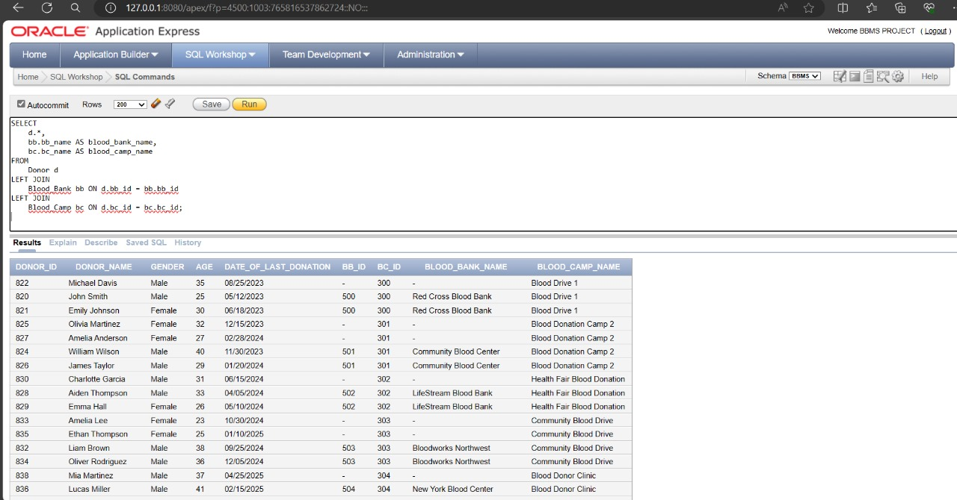

Slide 18
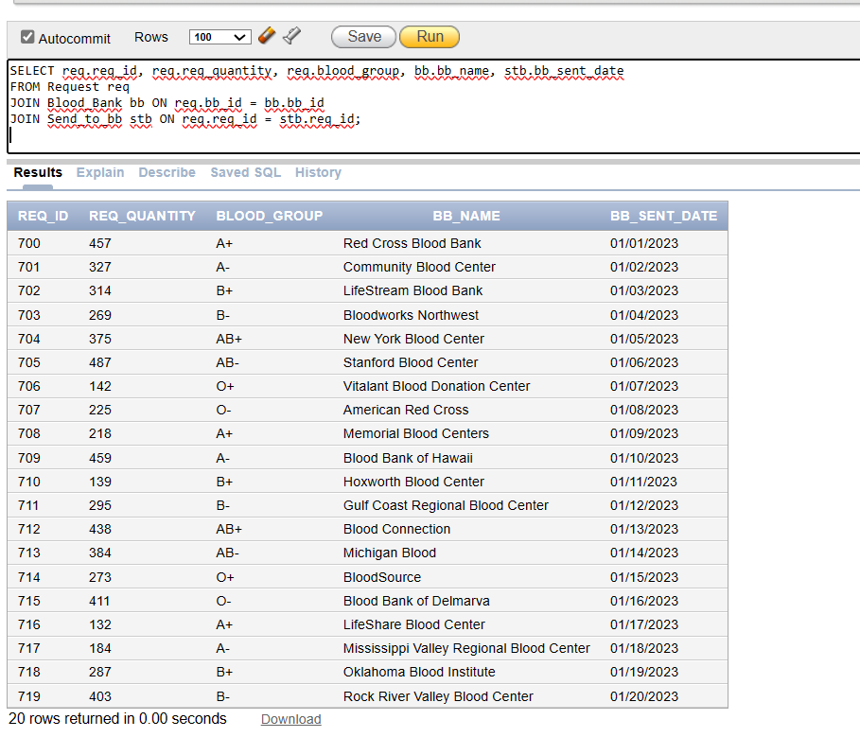
Query to retrieve requested blood quantity, blood group, blood bank name and the request sent date to the blood bank for all the request Id’s.
Query:
SELECT req.req_id, req.req_quantity, req.blood_group, bb.bb_name, stb.bb_sent_date
FROM Request req
JOIN Blood_Bank bb ON req.bb_id = bb.bb_id
JOIN Send_to_bb stb ON req.req_id = stb.req_id;

Slide 19


OBSERVATIONS
Tool Compatibility: Mixing PostgreSQL and Oracle usage among team members led to syntax clashes, requiring collaborative problem-solving.
Innovative Solutions: We implemented a virtual view to represent specific patient information, specifically first and last names. This approach allowed for clearer representation of patient identification while circumventing the complexities of normalization.
Referential Integrity Challenges: Clarifying relationships amidst cluttered arrows proved tedious; iterative cleanup was necessary for improved clarity.
Database Experience: Oracle facilitated intricate queries effectively, but its error messages occasionally lacked clarity, complicating troubleshooting efforts.

Slide 20



CONCLUSION
Our project has offered invaluable insights and allowed us to further develop our collaborative skills. With our database solution, blood distribution would become more efficient, and communication between blood banks and hospitals would be streamlined. Implementing an application like this could revolutionize the way blood is managed, ensuring timely access to vital information and enhancing safety measures throughout the supply chain, ultimately benefiting patients in need.

Slide 21
THANK YOU!!

